Slide 1
Mathematical Induction

Slide 2
PRINCIPLE OF MATHEMATICAL INDUCTION:
Let P(n) be a propositional function defined for all positive integers n. P(n) is true for every positive integer n if
1.Basis Step:
The proposition P(1) is true.
2.Inductive Step:
If P(k) is true then P(k + 1) is true for all integers k ≥ 1.
i.e. ∀k(p(k) → P(k + 1))
(P (1) ∧ ∀k(P(k) → P(k + 1))) → ∀nP (n)

Slide 3
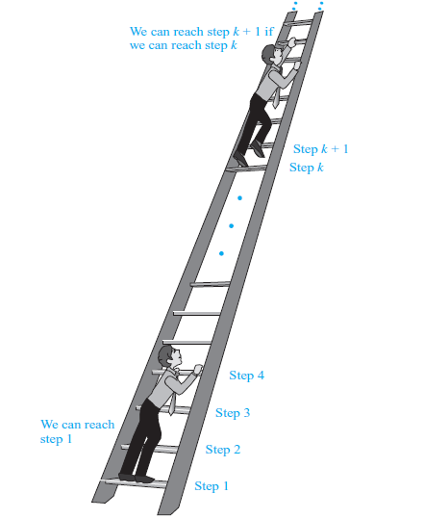
Climbing an Infinite Ladder.

Slide 4
EXAMPLE 1:
Use Mathematical Induction to prove that
for all integers n ≥1.
SOLUTION:
Let
1.Basis Step:
P(1) is true.
For n = 1, left hand side of P(1) is the sum of all the successive integers starting at 1
and ending at 1, so LHS = 1 and RHS is
so the proposition is true for n = 1.

Slide 5
2. Inductive Step: Suppose P(k) is true for, some integers k ≥ 1.
(1)
To prove P(k + 1) is true. That is,
(2)
Consider L.H.S. of (2)
Hence by principle of Mathematical Induction the given result true for all integers greater or equal to 1.

Slide 6
EXAMPLE 3:
Use Mathematical Induction to prove that
1+2+2² + … + 2^{n} = 2^{n+1} - 1 for all integers n ≥0.
SOLUTION:
Let P(n): 1 + 2 + 2² + … + 2^{n} = 2^{n+1} - 1
Basis Step:
P(0) is true.
For n = 0
L.H.S of P(0) = 1
R.H.S of P(0) = 2⁰⁺¹ - 1 = 2 - 1 = 1
Hence P(0) is true.

Slide 7
2. Inductive Step:
Suppose P(k) is true for some integer k ≥ 0; i.e.,
1+2+2²+…+2^{k} = 2^{k+1} – 1……………………(1)
To prove P(k+1) is true, i.e.,
1+2+2²+…+2^{k+1} = 2^{k+1+1} – 1…………………(2)
Consider LHS of equation (2)
1+2+2²+…+2^{k+1}= (1+2+2²+…+2^{k}) + 2^{k+1}
= (2^{k+1} - 1) +2^{k+1}
= 2·2^{k+1} - 1
= 2^{k+1+1} - 1 = R.H.S of (2)
Hence P(k+1) is true and consequently by mathematical induction the given propositional function is true for all integers n≥0.

Slide 8
EXAMPLE 5:
Use Mathematical Induction to prove that
for all integers n ≥1.
SOLUTION:
Let P(n) denotes the given equation
Basis Step:
P(1) is true.
For n = 1
L.H.S of P(1) =
R.H.S of P(1) =
So L.H.S = R.H.S of P(1).Hence P(1) is true

Slide 9
2.Inductive Step:
Suppose P(k) is true for some integer k ≥1;
(1)
To prove P(k+1) is true; i.e.;
(2)
Consider LHS of above equation (2)

Slide 10
Consider LHS of above equation (2)
Hence P(k+1) is also true and so by Mathematical induction the given equation is true for all integers n ≥1.

Slide 11
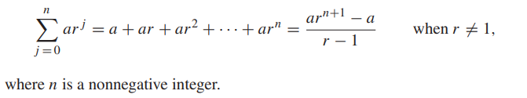
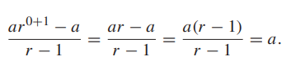


EXAMPLE 6: Sums of Geometric Progressions
Use Mathematical Induction to prove that
SOLUTION:
Basis Step:
P(0) is true.
For n = 0
L.H.S of P(0) = = $a$
R.H.S of P(0) =
So L.H.S = R.H.S of P(0).Hence P(0) is true
$$ar^{0}$$

Slide 12





2.Inductive Step:
Suppose P(k) is true for some integer k ≥1;
$a+ar+ar^{2}+ar^{3}$+… $+ar^{k}= \frac{{ar}^{k+1}−a}{r−1}$
(1)
To prove P(k+1) is true; i.e.;
$a+ar+ar^{2}+ar^{3}$+… $+ar^{k+1}= \frac{{ar}^{k+1+1}−a}{r−1}$
(2)
Consider LHS of above equation (2)
$a+ar+ar^{2}+ar^{3}$+… $+ar^{k+1}$
$a+ar+ar^{2}+ar^{3}$+…$ar^{k}+ar^{k+1}$
$\frac{{ar}^{k+1}−a}{r−1}$ $+ar^{k+1}$
$\frac{{ar}^{k+1}−a}{r−1}$ $+\frac{{ar}^{k+1}(r−1)}{r−1}$
$\frac{{ar}^{k+1}−a}{r−1}$ $+\frac{{ar}^{k+2}−{ar}^{k+1}}{r−1}$

Slide 13


$\frac{{ar}^{k+1}−a}{r−1}$ $+\frac{{ar}^{k+2}−{ar}^{k+1}}{r−1}$
$$\frac{{ar}^{k+1}−a+{ar}^{k+2}−{ar}^{k+1}}{r−1}$$
$$\frac{{ar}^{k+2}−a}{r−1}$$
= R.H.S of (2)
Hence P(k+1) is true and consequently by mathematical induction the given propositional function is true for all integers n≥0.

Slide 14
EXAMPLE 7:
Use Mathematical Induction to prove the inequality
n < 2^{n}
for all positive integers n.
SOLUTION:
Basis Step:
P (1) is true, because 1 < 2¹ = 2.
This completes the basis step

Slide 15
2.Inductive Step:
Suppose P(k) is true for some integer k ≥1;
k < 2^{k}
(1)
To prove P(k+1) is true; i.e.;
k +1 < 2^{k+1}
(2)
Taking L.H.S of eq 2
k +1
k +1 < 2^{k} +1
k +1 ≤ 2^{k} + 2^{k} since1 ≤ 2^{k}
k +1 ≤ 2.2^{k}
k +1 ≤ 2^{k+1}
This shows that P (k + 1) is true, namely, that k + 1 < 2k+1, based on the assumption that P (k) is true.
we have shown that n < 2n is true for all positive integers n.

Slide 16
ANOTHER METHOD
add 1 to both sides of k < 2^{k}
Multiplying 2 to both sides of k < 2^{k}
k +1 < 2^{k} +1
2k < 2.2^{k}
k +1 ≤ 2^{k} + 2^{k} since1 ≤ 2^{k}
k + k < 2^{k+1}
k +1 ≤ 2.2^{k}
k + 1 < 2^{k+1} since 1≤ k
k +1 ≤ 2^{k+1}
This shows that P (k + 1) is true, namely, that k + 1 < 2k+1, based on the assumption that P (k) is true.
we have shown that n < 2n is true for all positive integers n.

Slide 17
EXAMPLE 8:
Use mathematical induction to prove that 2^{n} < n! for every integer n with n ≥ 4. (Note that this inequality is false for n = 1, 2, and 3.)
SOLUTION:
Basis Step:
To prove the inequality for n ≥ 4 requires that the basis step be P (4).
P (4) is true, because 2⁴ < 4!
16 < 24

Slide 18
2.Inductive Step:
Suppose P(k) is true for some integer k ≥1;
2^{k} < k!
(1)
To prove P(k+1) is true; i.e.;
2^{k+1} < (k+1)!
(2)
2^{k+1} = 2 · 2^{k} by definition of exponent
< 2 · k! by the inductive hypothesis
< (k + 1)k! because 2 < k + 1
= (k + 1)! by definition of factorial function
This shows that P (k + 1) is true when P (k) is true. This completes the inductive step of the proof.
That is, we have proved that 2n < n! is true for all integers n with n ≥ 4.

Slide 19
EXAMPLE 9:
Use Mathematical Induction to prove that
SOLUTION:
Let P(n) denotes the given equation
Basis Step:
To prove the formula for n = 0, we need to show that
Now, L.H.S =
R.H.S = 0·2² + 2 = 0 + 2 = 2
So L.H.S = R.H.S of P(0).Hence P(0) is true

Slide 20
2.Inductive Step:
Suppose P(k) is true for some integer k ≥0;
(1)
To prove P(k+1) is true; i.e.;
Consider LHS of above equation (2)
Hence the inductive step is proved as well. Accordingly by mathematical induction the given formula is true for all integers n≥0.

Slide 21
A Harmonic Progression (HP) is defined as a sequence of real numbers which is determined by taking the reciprocals of the arithmetic progression that does not contain 0.
For example, the sequence a, b, c, d, …is considered as an arithmetic progression; the harmonic progression can be written as 1/a, 1/b, 1/c, 1/d, …

Slide 22
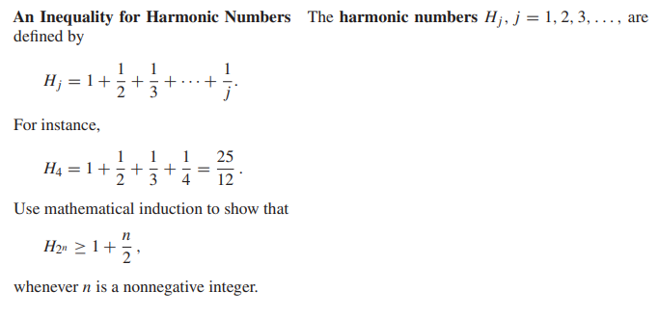
EXAMPLE 10: An Inequality for Harmonic Numbers
Basis Step:
P (0) is true, because H₂⁰ = H1 = 1 ≥ 1 + 0/ 2 .

Slide 23
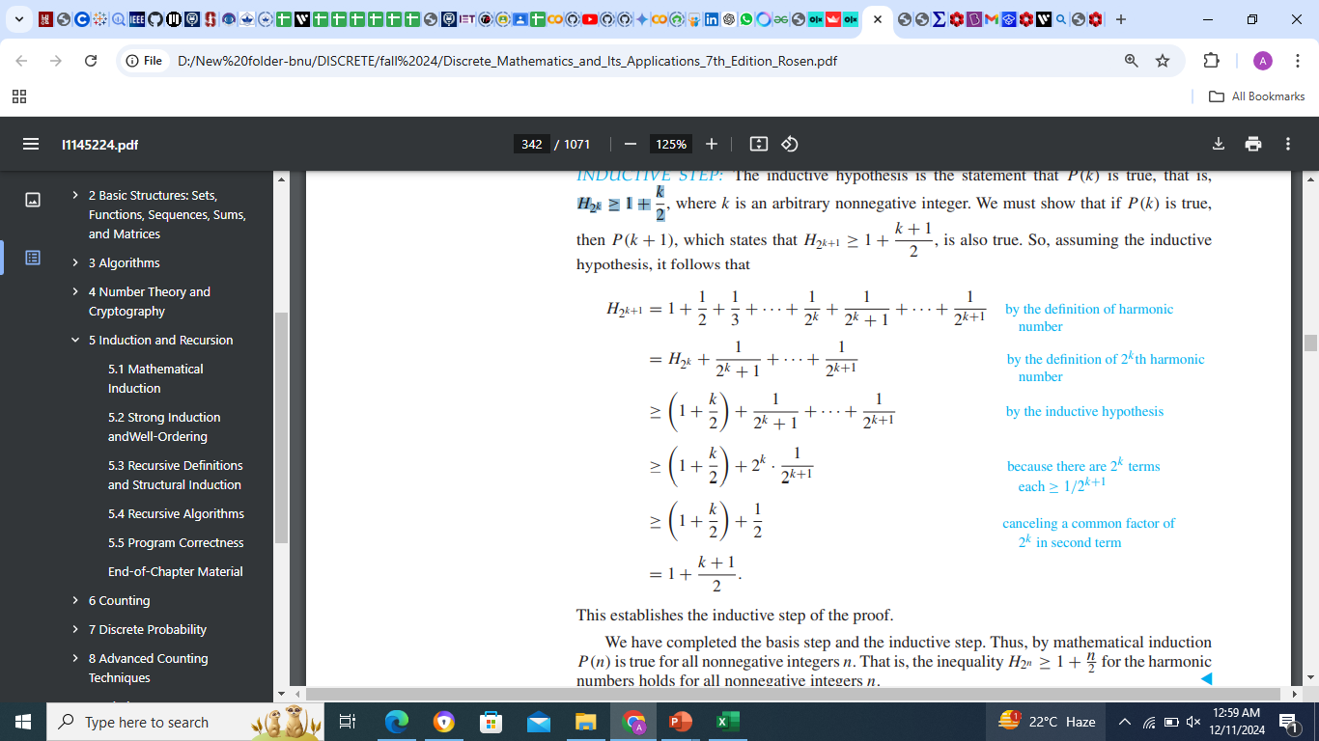
2.Inductive Step:
Suppose P(k) is true for some integer k ≥1;
H₂^{k} ≥ 1 + k /2
(1)
To prove P(k+1) is true; i.e.;
H₂^{k+1} ≥ 1 +( k+1) /2
(2)
the inequality H₂^{n} ≥ 1 + n /2 for the harmonic numbers holds for all nonnegative integers n.

Slide 24
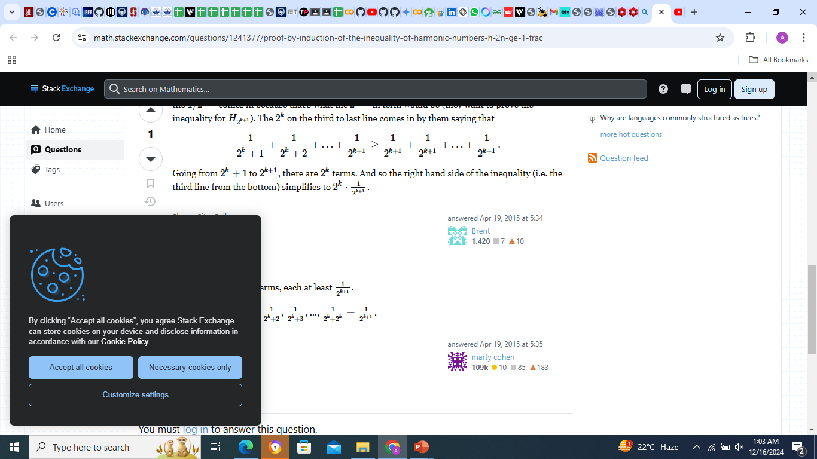
2.Inductive Step:
Suppose P(k) is true for some integer k ≥1;
H₂^{k} ≥ 1 + k /2
(1)
To prove P(k+1) is true; i.e.;
H₂^{k+1} ≥ 1 +( k+1) /2
(2)

Slide 25
The inequality H₂^{n} ≥ 1 + n /2 for the harmonic numbers holds for all nonnegative integers n.

Slide 26
Exercise
3
15
18
Use Mathematical Induction to prove that
1+3+5+…+(2n -1) = n² for all integers n ≥1.

